Slide 1
Computer organization and architecture
Shriram K Vasudevan
Session – 1

Slide 2
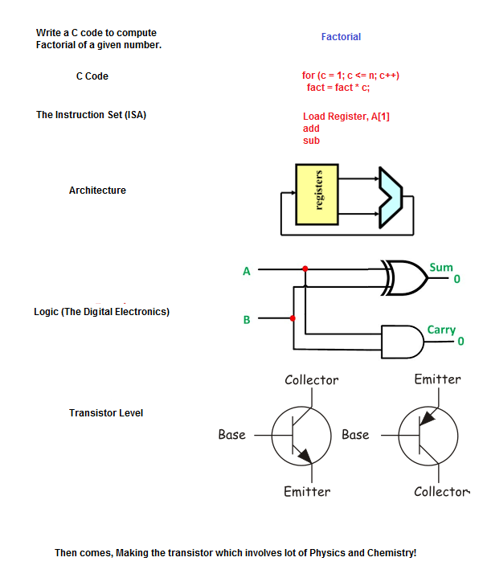
Can you look at this diagram for a min?

Slide 3
What is Computer Architecture and Organization?
Architecture will always concerned with what to do?
Organization will take care of how to do?
In simple terms, architecture is concerned with the design and organization is concerned with the building process.
Architecture shall carry out the analysis and zeroing in about the instructions, modes of addressing and usage of registers.
Computer architecture carries the precedence than Computer organization.
I.e. only after the design, the implementation can be done.
It is to be compared with high level design.
For example, if a calculator is built, it is to be decided if it will support the division operation is an architectural analysis. Likewise, all the features which a computer has are defined at architectural phase.

Slide 4
Contd.,
Organization is the next phase to architecture.
Or, organization is dependent on architectural decisions.
Realization of the architectural decisions happens through the organization.
The same example of Division operation is now to be seen from the organization perspective.
Having decided to support Division operation, organization shall enable to have the division done through the repeated subtraction or through division unit.
This decision of if to go with repeated subtraction or otherwise is the role of Organization.
Organization shall also help in identifying or uncovering design issues or challenges.

Slide 5
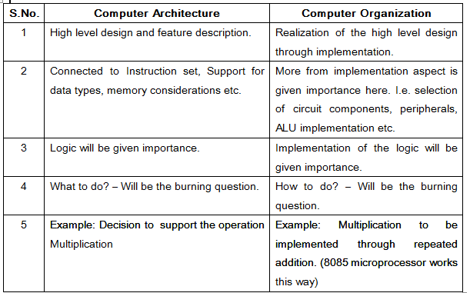
Let us compare!

Slide 6
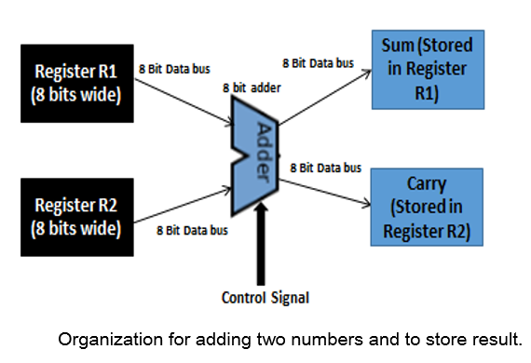
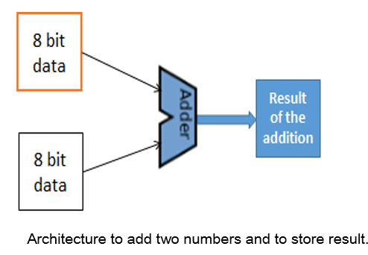
Hence, we can conclude this way!

Slide 7
Computer organization and architecture
Shriram K Vasudevan
Session – 2

Slide 8
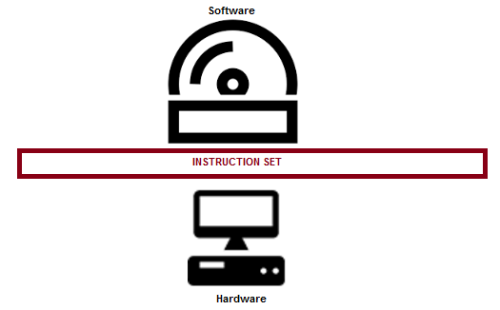
ISA – Instruction Set Architecture
Instruction Set Architecture, ISA, is an interface between the hardware and software and it is indeed playing the role of an instructor to instruct the hardware about what to be done through the software instructions.
In other words, ISA helps to utilize the hardware to its complete ability through the software instructions.
It is a mediator and acts as a frontier amid the software and hardware.

Slide 9
Contd.,
ISA helps in defining the operations, modes of operation supported, addressing, storage related inputs, how to use, perhaps, how to access the operands through instructions etc.
In short, or more precisely, one could say that, a processor is detailed through the instruction set architecture.
There are many processors and there could be many ISAs.
The ISA would support multiple instructions and instruction types based on the processor selected.
The instructions specified by the ISA shall be well interpreted by the processor and corresponding action shall be initiated. ISA is a collection of instructions and formats supported for the processor. Through ISA, i.e. instructions one can access the resources.

Slide 10
Contd.,
A = B + C (ADD A, B, C)
Where,
A has the result of the operation
B and C are the operands which are to be added. (B and C are called registers, which has values inside)
“+” is the operation, i.e. addition.
“=” is the assignment operation, after the expression is evaluated, the result shall be assigned to A.
The same addition expression mentioned above shall be accomplished through the instruction ADD A, B, C where B and C are the source registers with A being the destination register.

Slide 11
Contd.,
Now, it is ISA’s role shall come here in deciding the following very important considerations.
What is the operation to be performed?
Where to store the operands?
Where to store the result of the operation?
How many operands are needed to perform (this) operation?
Does the ISA support the operation specified? (For an instance 8085 does not support multiplication and division).
What is the type of the operation? (it can be classified, reader shall be introduced to this)
What is the format of the operation?
Size of the operands.
What are the addressing modes supported? How to address the operands?

Slide 12
Computer organization and architecture
Shriram K Vasudevan
Session – 3

Slide 13
Types of ISA – An understanding
Some call it classes, some call it types.
We can retain the term types of ISA for the discussion purpose. There are four types of ISA.
They are listed as follows, one after another.
Accumulator
Stack
Register (General purpose)
Register (Load and Store)

Slide 14
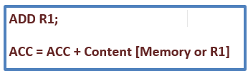
Contd.,
Accumulator:
This is normally referred as 1-address type of ISA.
In this approach, the content from a memory location or a specified register shall be added with the content available in the accumulator register and the result obtained shall also be stored back into the accumulator.
Here, in this approach, accumulator is the main component and carries more focus. This approach is accumulator centric.

Slide 15
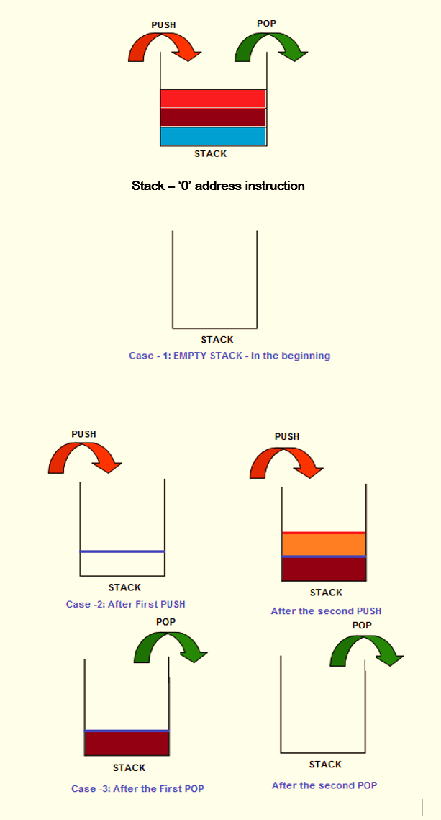
Contd.,
Stack:
This is often regarded as 0 address instruction.
Here, the user need not have to mention any operand and the instruction is operand less.
Means, a PUSH instruction shall push the content into the stack and POP shall pop the content out from the stack to a register.
The contents shall be added to the stack through the reference to the top of the stack.
The instructions to be remembered are “PUSH and POP”. This is a very simple approach and effective too.

Slide 16
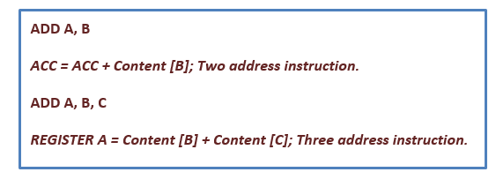
Contd.,
Register: (general purpose approach)
This is an approach where, general purpose registers shall be involved in the operation.
Here, in this approach the contents from the registers (operands) shall be used and when the result is available shall be stored in another register.
It could even be accumulator to store the result.
Here, there are two options. One, there can be 2 operands.
Secondly, there can be three operands.

Slide 17
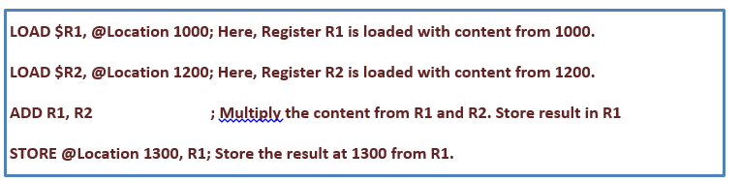
Contd.,
Register (Load and Store)
This ISA will demand the operands to be moved to the registers and only then the operation can be carried out.
For an instance, if you want to add two numbers, first, the two numbers (operands) should be stored in the registers and then the ALU can be fed with the input.
LOAD is used to move the data from the memory location to registers and STORE does it reverse.
Anything and everything in this approach shall be done through the registers and no direct memory access is encouraged.
This is what is referred as “RISC” architecture.
It can be represented as 2-address or 3 - address instruction based on the requirement.

Slide 18
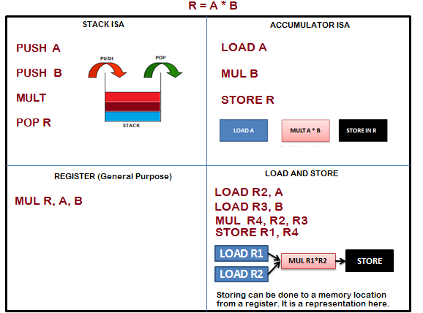
Contd.,
Expression to be implemented with all the four ISA types: R = A *B

Slide 19
Computer organization and architecture
Shriram K Vasudevan
Session – 4

Slide 20
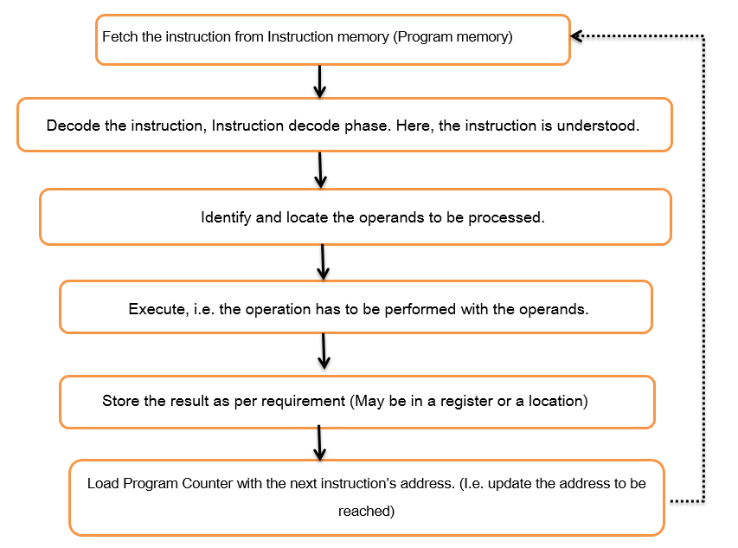
Instruction Execution Cycle and Terms Recap.
A program is nothing but collection of instructions and all the instructions gets pulled one after another from the memory (don’t worry which memory we are talking about, it is just memory).
Then, the process of understanding what the instruction is all about begins.
Followed by this, there would be computation and storing the result.
One can simply call this as Fetch, Decode and Execute, which is more technical as well.
But, to establish a better understanding it is needed to go with a deeper flow. (see RHS)

Slide 21
Some fundamental terms for recap…
Program counter: A register which holds the address of the next instruction (subsequent instruction) to be executed. This enables faster execution. Program counter is a register and it cannot be accessed by the programmer. Or, the programmer does not know the address of the program counter. It is purposefully hidden from the programmers view.
Stack and Stack Pointer: Stack is a temporary storage area where the values can be stored. For an instance when a function is called like add (3,4), the arguments 3,4 would be kept in the stack (the operation is called pushing) and it is a temporary storage area. Once the function call is done and result is ready, the result will be again kept on the top of the stack. Once the execution is complete, the stack can be cleaned (the operation is referred to as popping). Stack pointer is a register used to point the stack.
Bus: The channel through with the information flows. The data could be the address or the data from a particular location. If the bus carries the data, it is called data bus and in case addresses go through the bus, it is referred as address bus. There are control signals to be sent for controlling actions and in that case, the bus is referred as control bus.

Slide 22
CISC vs. RISC
SHRIRAM K VASUDEVAN
Recap from previous semester.

Slide 23
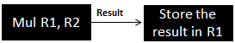
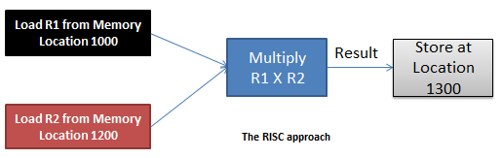
INTEL
The CISC Approach
MUL R1, R2 ; Multiply the content from R1 and R2. Store result in R1
APPLE COMPUTERS
LOAD $R1, @Location 1000; Here, Register R1 is loaded with content from 1000.
LOAD $R2, @Location 1200; Here, Register R2 is loaded with content from 1200.
MUL R1, R2 ; Multiply the content from R1 and R2. Store result in R1
STORE @Location 1300, R1; Store the result at 1300 from R1.

Slide 24
So…
Intel believes in hardware bearing more responsibility, making the coding simple. I.e. the developers shall be writing minimal lines of code. Apple believes the other way round. The philosophy is, hardware has to be simple and software has to lift most of the responsibility. Means, the developers will have a tough job of writing more lines of code with this architectural approach

Slide 25
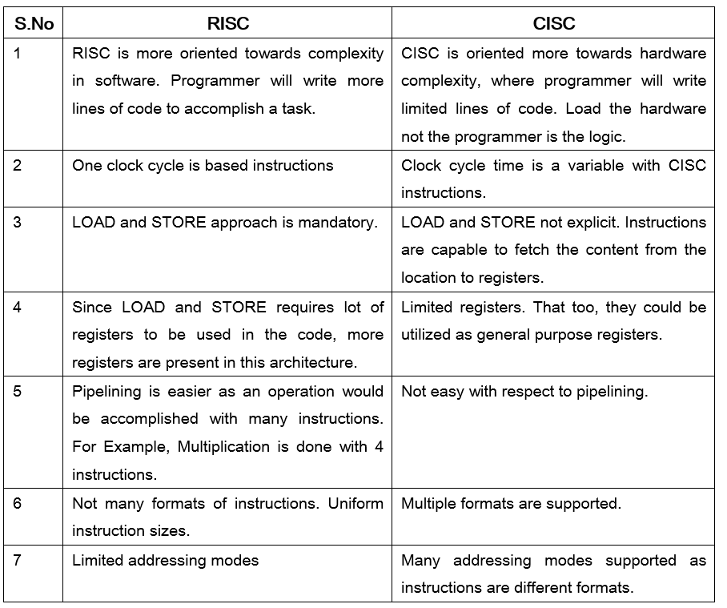

Slide 26
Little Endian and Big Endian Formats – A Clear understanding.
Shriram K Vasudevan
Recap from previous semester.

Slide 27
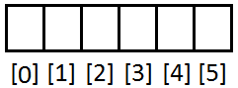
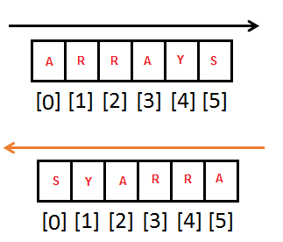
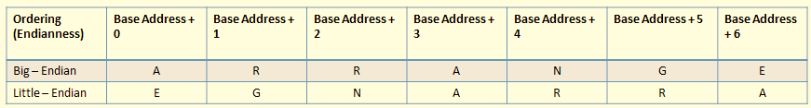
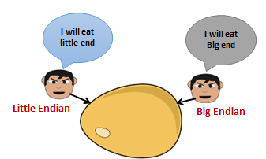
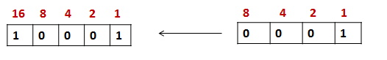
AN EMPTY ARRAY
The advantage!
S.NO | Little Endian | Big Endian
1 | MS Paint | JPEG
2 | RTF | Adobe Photoshop
3 | BMP | Mac Paint

Slide 28
Harvard and Von-Neumann Architecture – Let’s uncover the jargons
Shriram K Vasudevan
Recap from previous semester.

Slide 29
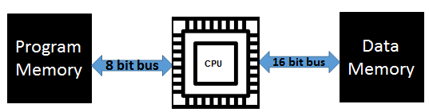
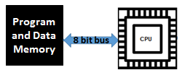
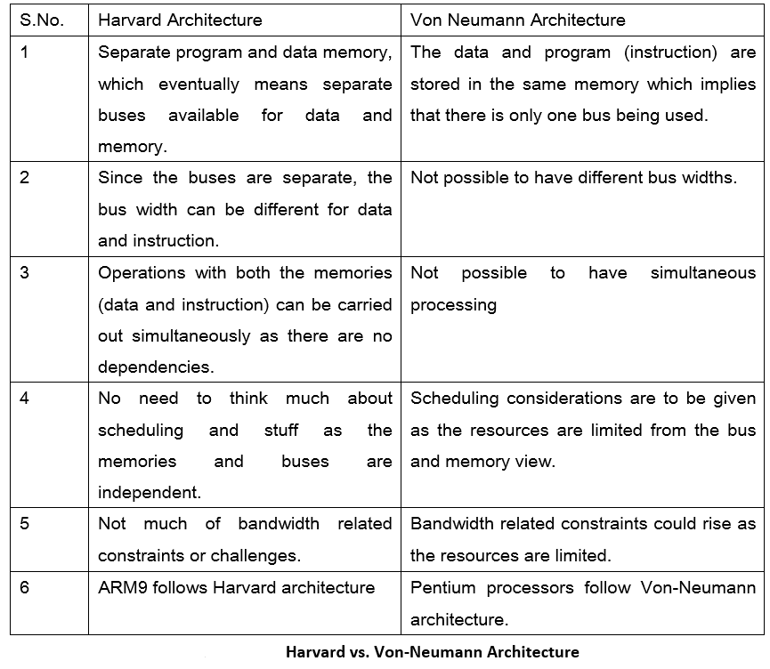
Harvard Architecture – A diagrammatic representation
Von Neumann Architecture – A diagrammatic representation.

Slide 30
Thanks
Shriram K Vasudevan

Slide 31
Addressing modes
Shriram K Vasudevan

Slide 32
Remember
Addressing mode: The rule for interpreting or modifying the address field of an instruction.
Effective address: The address of operand produced by the application of the rule for interpreting or modifying the address field of the instruction before the operand is actually referenced.

Slide 33
Addressing Modes How do I travel to the destiny?
Common addressing modes are:
Immediate
Direct
Indirect
Register
Register Indirect
Displacement (Indexed)
Stack

Slide 34
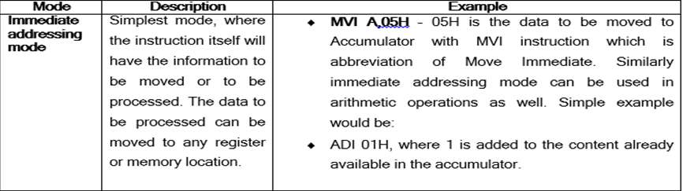
Immediate Addressing
Instruction
OPCODE OPERAND

Slide 35
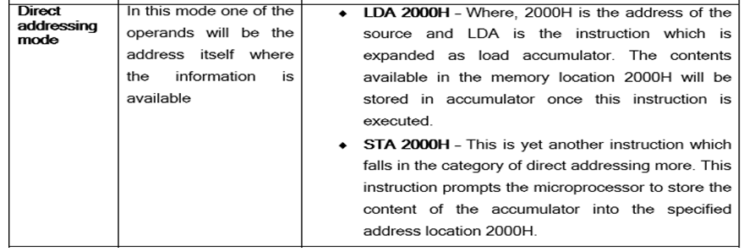
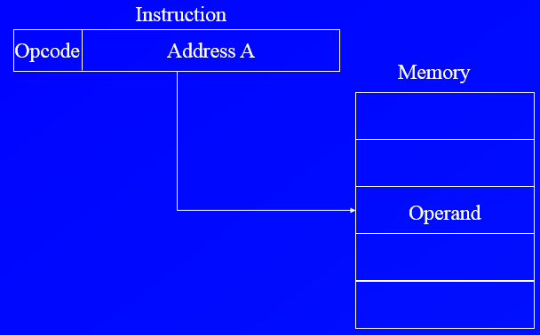
Direct Addressing Mode.

Slide 36
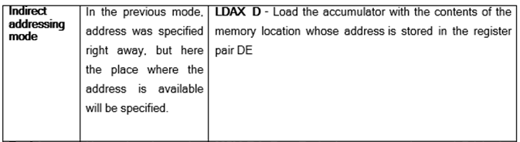
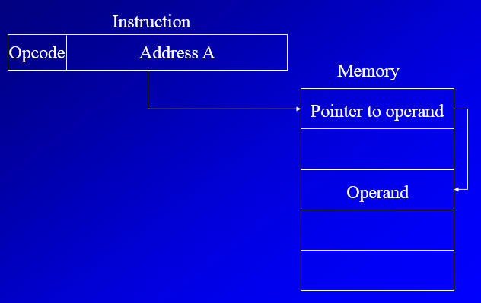
Indirect Addressing mode..

Slide 37
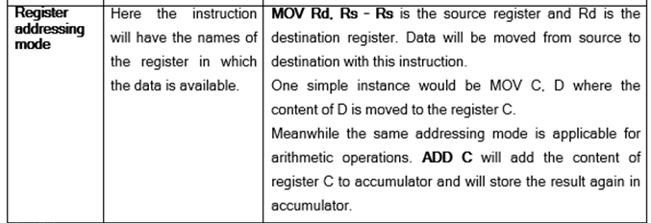
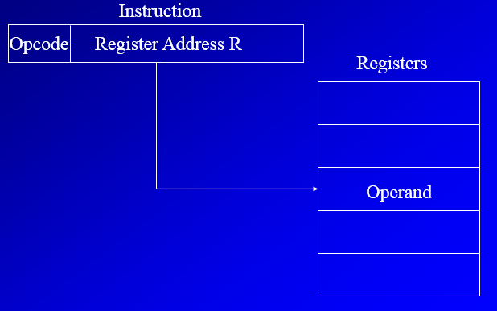
Register Addressing Mode.

Slide 38
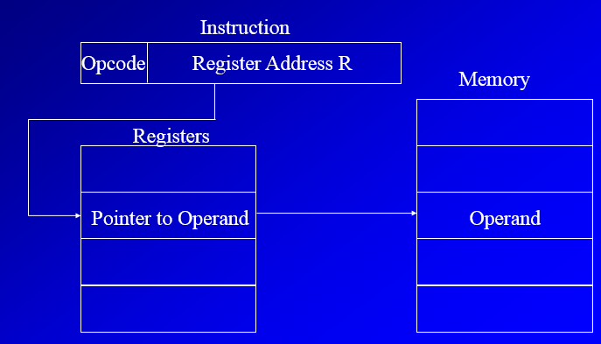
Register Indirect Addressing
EA = (R)
Register indirect addressing is similar to indirect addressing, except that the address field refers to a register instead of a memory location.
Operand is in memory cell pointed to by contents of register R

Slide 39
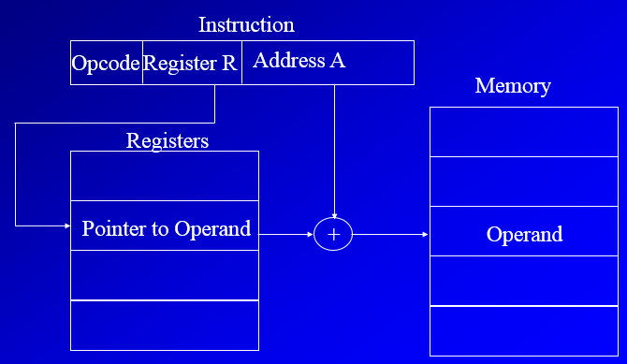
Displacement Addressing (indexed)
EA = A + (R)
Address field hold two values
A = base value
R = register that holds displacement
or vice versa
A very powerful mode of addressing combines the capabilities of direct addressing and register indirect addressing, which is broadly categorized as displacement addressing

Slide 40
Stack addressing mode..
Operand is (implicitly) on top of stack
e.g.
ADD Pop top two items from stack and add

Slide 41
Let us go to mips
Shriram K Vasudevan
Session 5

Slide 42
What is MIPS?
It is not Million Instructions Per Second, here! ☺
Expanded as Microprocessor Without Interlocked Pipeline Stages.
It is an ISA with 32 bit instructions. (Means, all instructions are 32 bits wide)
It is completely RISC architecture. (Means, it is all about load and store)
Any RISC architecture would eventually support FIXED WIDTH instructions and it is actually beneficial (You will understand this soon)
A very important point to note is “All these instructions must be stored at “WORD-ALIGNED address”.
What is that?
Word aligned address means, the addresses are divisible by 4. (Must be, we shall learn more about this, shortly)

Slide 43
MIPS – How it all happened? From where did we reach MIPS?
How did it grow? It started with Motorola and Intel.
Motorola 6800 / Intel 8085 (1970s)
1-address architecture: ADDA <addr>
(A) = (A) + (addr)
Intel x86 (Early 80s)
2-address architecture: ADD EAX, EBX
(A) = (A) + (B)
MIPS architecture (Early 90s)
3-address architecture: ADD $2, $3, $4
($2) = ($3) + ($4)

Slide 44
Let’s understand this as well.
MIPS has the following design considerations.
It is designed with having high level languages in mind. Means, usage of high level languages is much easier with MIPS.
MIPS does not demand the programmer to learn many addressing modes or instructions. It is all simple here and one could learn MIPS with ease.
Increased parallelism and also classy pipelining supported in MIPS. (Remember the production lines)
100% Load and Store architecture.
Increased flexibility with providing more number of general purpose registers (Compare ARM with 8085 folks)
All instructions are 32 bits wide. Hence, there is a uniformity internally enabled.
Hardware design considerations are easier when it is all uniform.

Slide 45
MIPS Instructions
MIPS instructions are of the following types:
Arithmetic/logical/shift/comparison
Control instructions (branch and jump)
Load/store
Other (exception, register movement to/from GP registers, etc.)
Let us learn this one after another.
Again, classified as I Type, R Type, J Type instructions.
All the instructions shall fall under any of these instruction types.

Slide 46
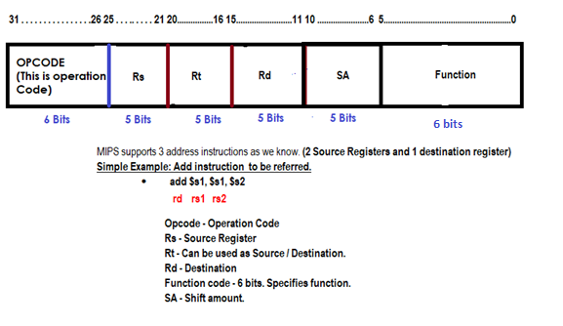
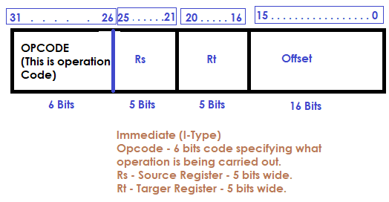
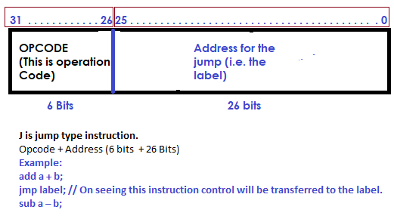
Let us understand how it looks like…
R Type

Slide 47
DESIGN RULES – part 1
Shriram K Vasudevan
Session 6

Slide 48
Let us learn the instructions. But, with some design rules in place.
A question that anyone can answer is to be asked.
Can I speak with you in Latin and will you understand (Assuming you do not know Latin)?
Answer is overt. And yes, you wont understand.
Hence, it is important to communicate to someone in the language he/she understands.
What is computer’s language?
Undoubtedly, it is instructions.
All instructions are grouped under one housing unit called Instruction Set. What we will see in this chapter?
So, what next?
We should learn how to talk to a computer and how computer could interpret it as well.
We can cite this as “Secret of Computing”.

Slide 49
MIPS writing / representation notations (This is like the coding guidelines)
We can take / cite some addition operation in this section to get the understanding constructed, solid.
Addition is the operation which we shall talk about as it is much easier and straight forward than anything else.
The instruction could be – add x, y, z
What this does?
Simple, add y and z. Store the result in X.
This is called MIPS representation.
Can we have any other notation to represent MIPS?
Come on. Not possible.
Extremely inflexible when it comes to MIPS.
Each operation will have 3 operands for sure. (means X, Y, Z)
Also, each operation could only perform one operation.
Means, it is addition. Only addition.
MSD is a batsman. No bowler. One action!

Slide 50
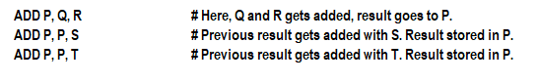
Lets add some fun…
Challenge – add the values at Q R S T registers and place the result in P.
How MIPS could do this?
Considering the restrictions thrown in the previous slide, we should get a solution.
Thus, we require 3 instructions to add 4 numbers (Costly, huh??)
MIPS guidelines say, each line can have one instruction, the max.
Comments always terminate at end of the line.
Just, MIPS things.

Slide 51
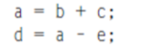
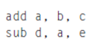
Fantastic Four – Design Rules
Rule 1 – Keep it simple. (Referred as Simplicity offers Regularity)
It is all simple with MIPS. We can now do something interesting.
This is C Programming approach…
The MIPS way..
Inference: Directly we mapped!

Slide 52
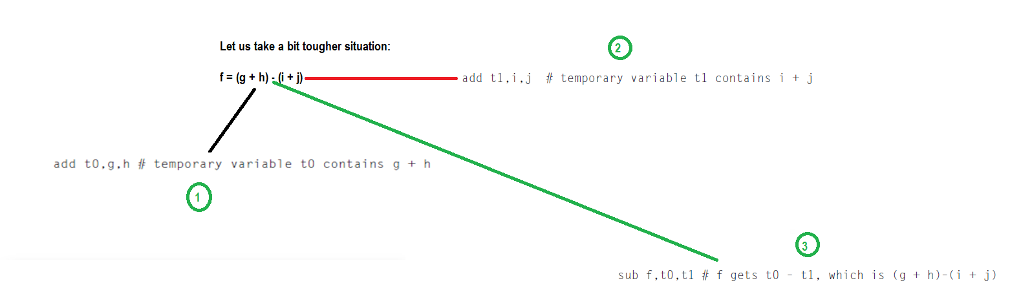
Contd.,
So it is easy with MIPS. Simplicity rendered to perform operations as good as it is in high level languages is an added advantage.

Slide 53
Lets go a bit deeper…
C or CPP has a facility which MIPS does not have. That is, storage luxury.
There are very limited storage options and register’s usage is inevitable.
Registers are going to be the heart, kidney and liver.
They are termed even as bricks of computer organization.
As discussed earlier, the size of MIPS registers is 32 bits.
In MIPS architecture, 32 bits together is termed as WORD.
A register is capable of storing a word is the point to be taken.

Slide 54

Inference
MIPS has 32 registers. (Everything is 32 here!)
So what?
We have added the restriction that the three operands of MIPS arithmetic instructions must each be chosen from one of the 32 32-bit registers.

Slide 55
Rule – 2 Make it smaller (As it would be faster)
If more number of registers are there, it would need more clock cycle time.
Why?
Simple. It will take electronic signals longer when they have to travel farther.
Also, 31 Registers may not be faster than 32 ☺
There are notations to be followed in MIPS architecture.
$ is used to represent a register.
$s0, $s1 → For Registers.
$t0, $t1 → Temp
clock cycle is the time between two adjacent pulses of the oscillator that sets the tempo of the computer processor.

Slide 56
Let us learn what R Type instructions are all about!!! Fun Ride!!!!
For R Type Instruction Remember the following stuff:
OPCODE IS ALWAYS 0.
“add” and “sub” both are R type instructions. Opcode for both of them is 0.
Compiler would differentiate the operations based on the function field (Operation code).

Slide 57
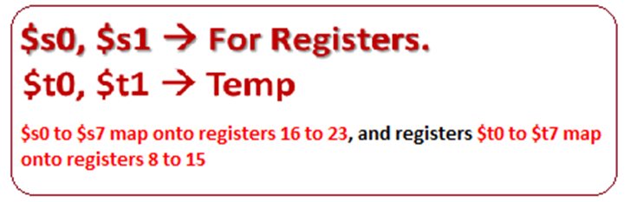
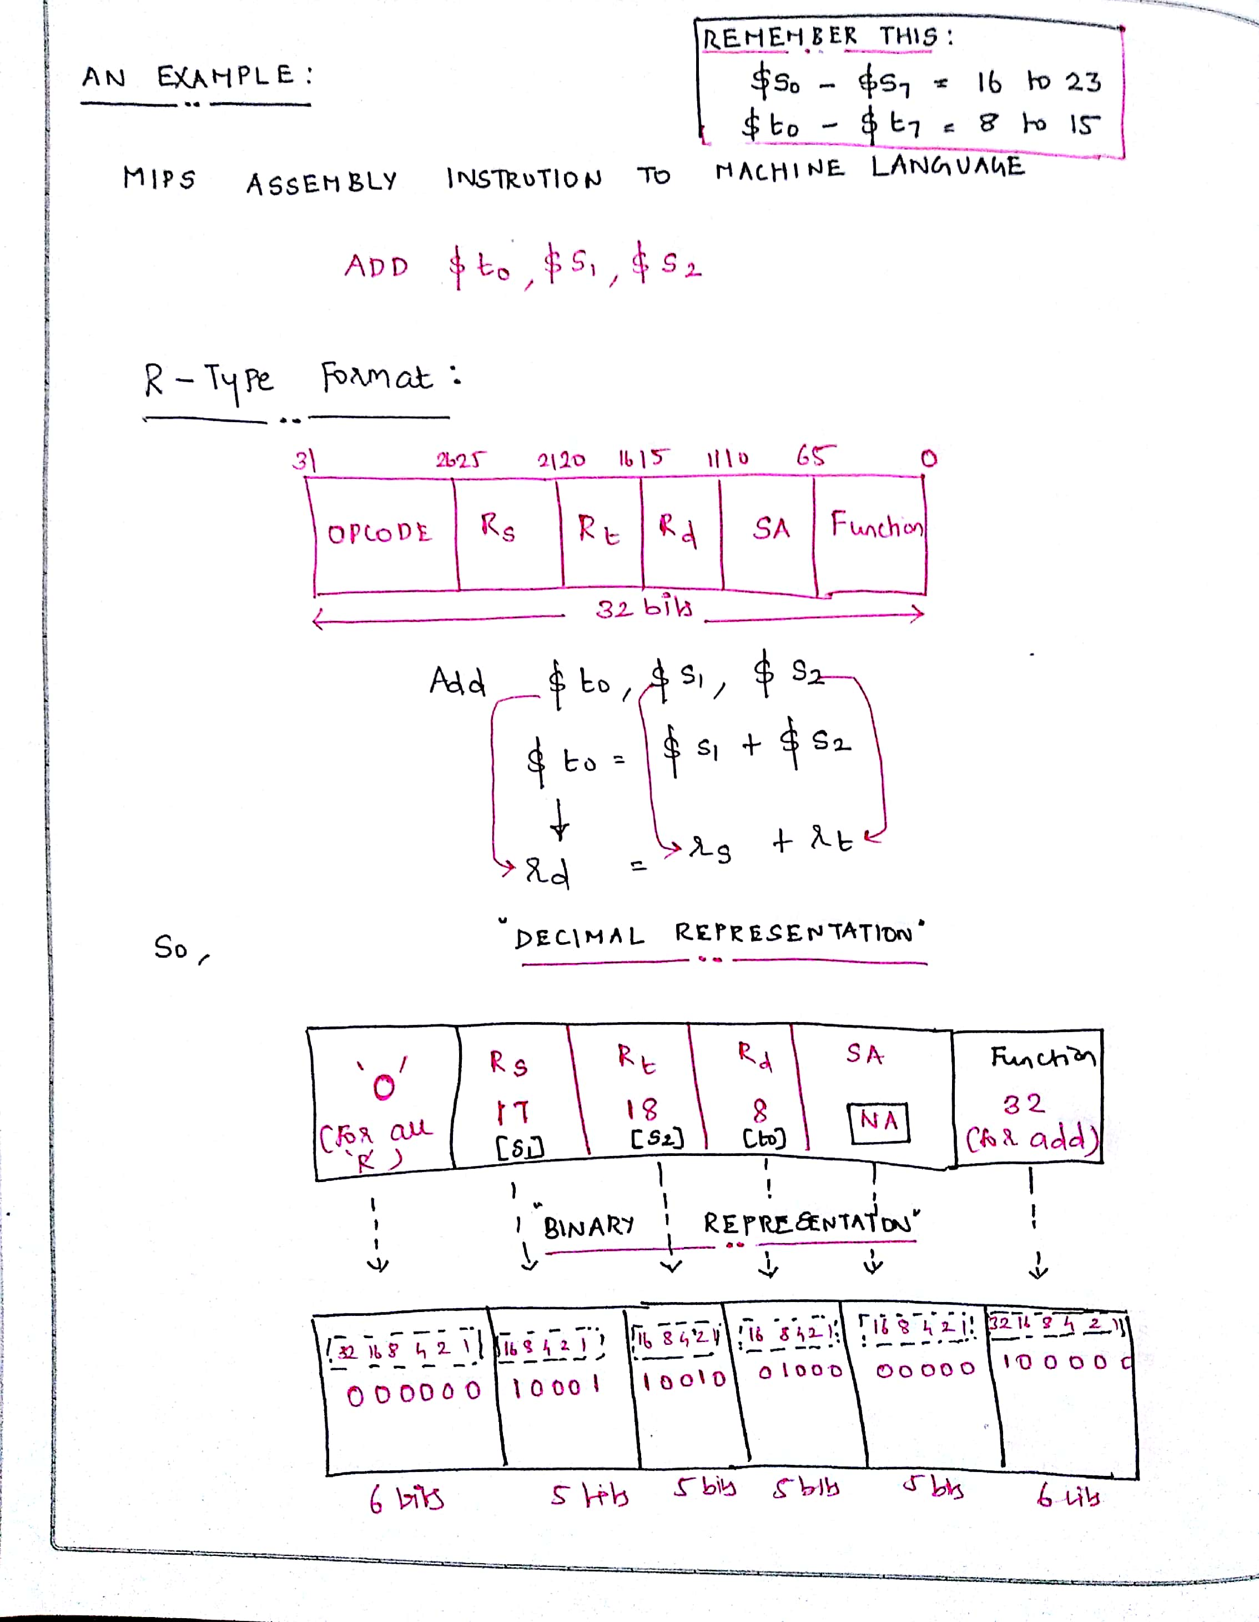
Contd.,
A Simple Home Work!! (Not really folks)

Slide 58
Understand this as well…
Are we and computer the same when we look at a number?
No, Not at all. We are unique!
Humans are capable of thinking everything as base 10 (Decimal).
Computers know only binary (0s and 1s)
25 base 10 = = 11001 base 2. (16 8 4 2 1)
registers $s0 to $s7 map onto registers 16 to 23, and registers $t0 to $t7 map onto registers 8 to 15.

Slide 59
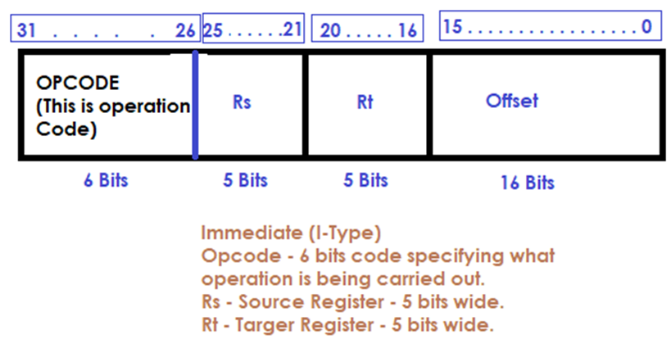
Lets learn I Type Instructions (Once this is done, we are half done)
Load Word and Store Word are the two instructions to be referred under this category.
Load -> Loads the data from the memory location specified to the register.
Store -> Takes the value from the register and stores in the specified memory location.

Slide 60

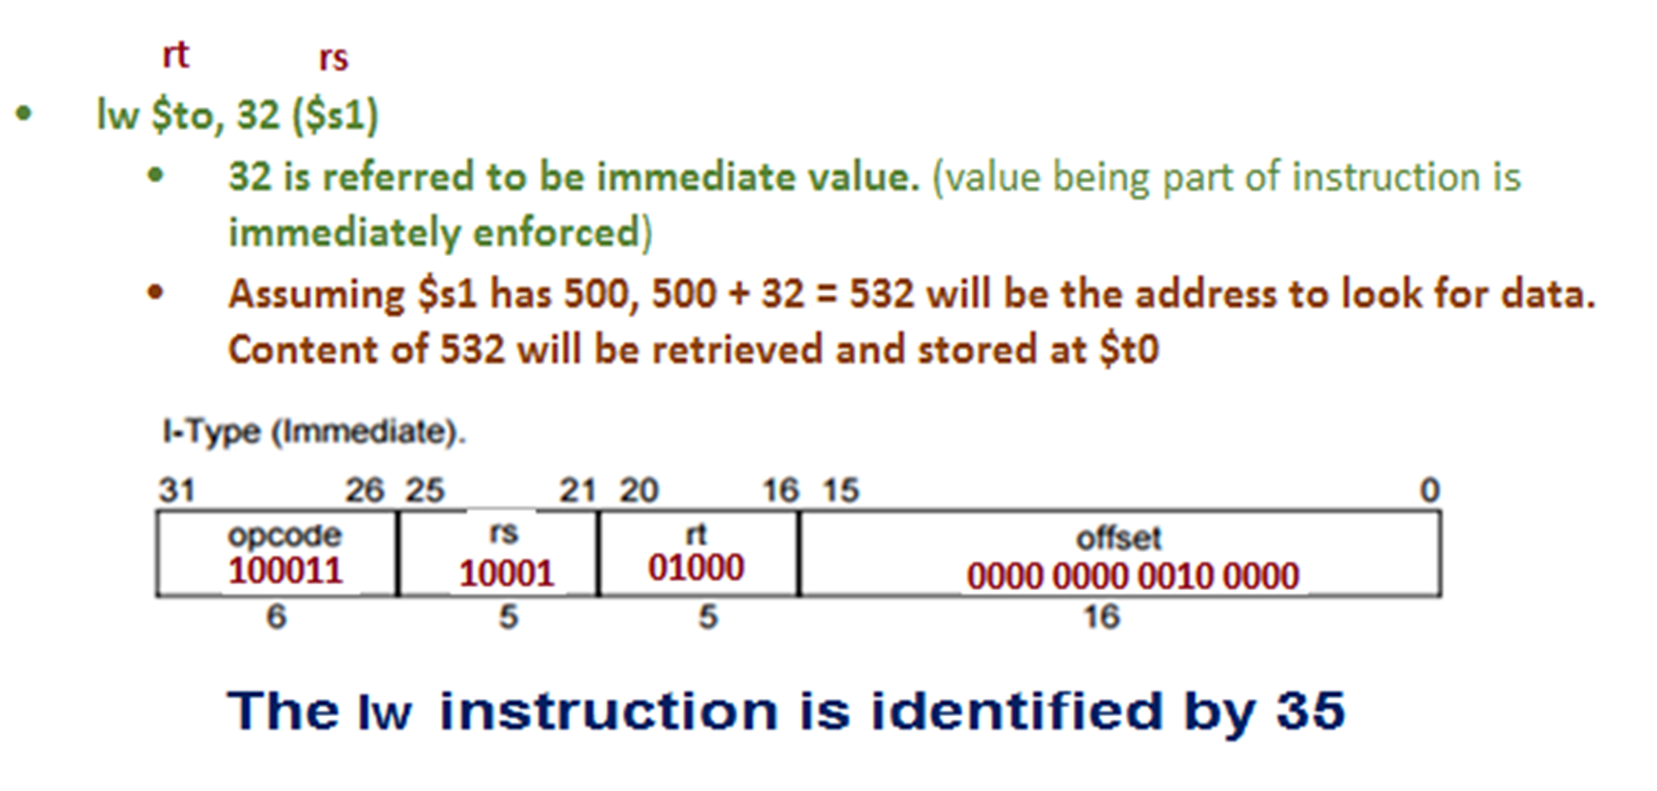
An instance:
lw $to, 32 ($s1)
32 is referred to be immediate value. (value being part of instruction is immediately enforced)
Assuming $s1 has 500, 500 + 32 = 532 will be the address to look for data. Content of 532 will be retrieved and stored at $t0

Slide 61
Lets also know this… Why we need load and store?
C or C P P for an instance support single data elements and complex data elements as well, which include array, structure and union.
How can a computer represent and access such large structures? (Worthy question right??) From COA perspective?
There are limited registers only made available in the processor.
Hence, naturally, very limited information / data can be stored in the registers.
But, a computer may have to handle so much data. Hence, data structures (arrays and structures) are kept in memory.
Arithmetic operations occur only on registers in MIPS instructions;
Thus, MIPS must include instructions that transfer data between memory and registers. Such instructions are called data transfer instructions.
To access a word in memory, the instruction must supply the memory address.
The data transfer instruction that copies data from memory to a register is traditionally called load and vice-versa is referred as store. Hence, we need load and store.

Slide 62
How much important is I TYPE Instruction (addi)
Many times a program will use a constant in an operation—for example, incrementing an index to point to the next element of an array.
An example is precise in this situation:

Slide 63
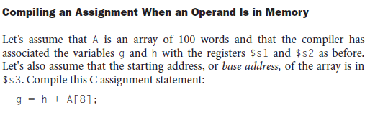
Contd., An Example Again…

Slide 64
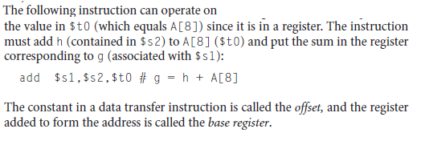
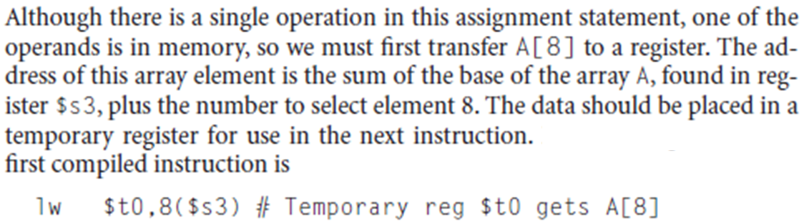
8 * 4 = 32

Slide 65
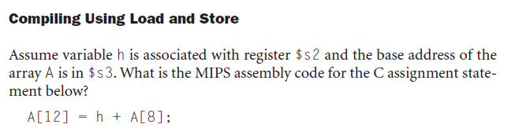
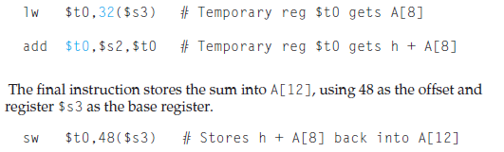
Although there is a single operation in the C statement, now two of the operands are in memory, so we need even more MIPS instructions.
The first two instructions are the same as the prior example, except this time we use the proper offset for byte addressing in the load word instruction to select A[8], and the add instruction places the sum in $t0:
Write the equivalent binary for this.. Work out now.

Slide 66
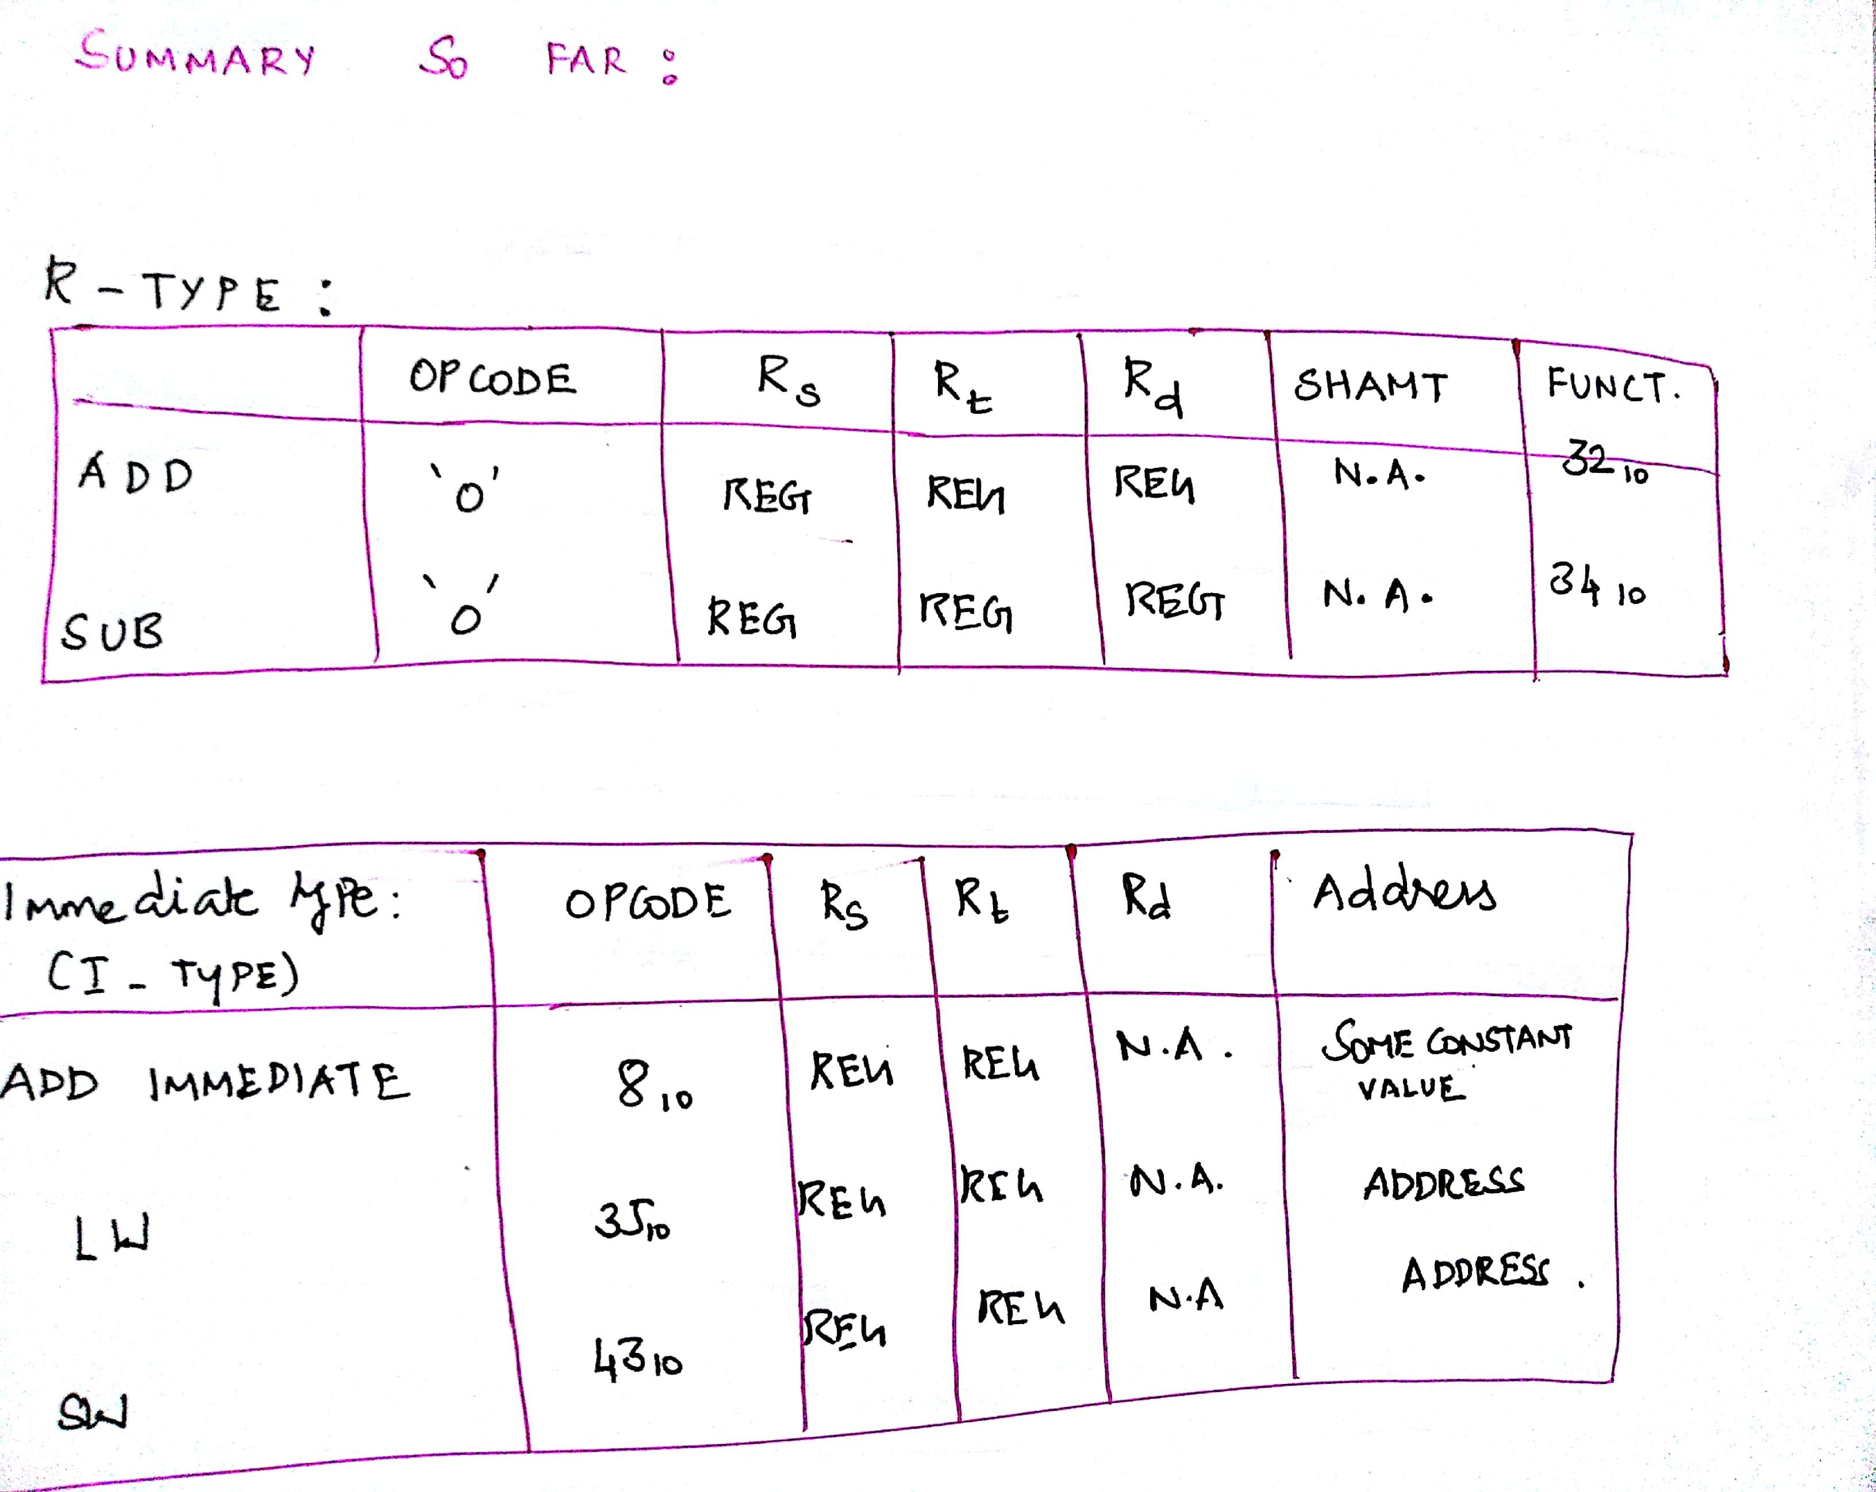
So far.. So good.
Add, Sub and Addi are arithmetic.
LW and SW are Data transfer Instructions.
For add, sub = R Type = Data in registers.
For Addi = Constant addition, to save time.
For Load = Data moved to register from memory
For Store = Data moved to memory from register.

Slide 67
DESIGN RULES – part 2
Shriram K Vasudevan
Session 7

Slide 68
Rule : 3 Make the common case fast.
We can never avoid constants in the instructions.
Particularly, when it comes to arithmetic instructions, constants remain inevitable.
Hence, use it as we used with Immediate Instructions as it would certainly be faster than if is getting loaded from memory.

Slide 69
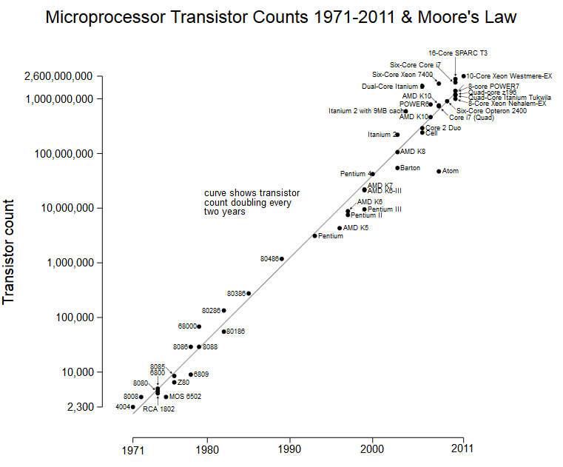
Remember this – This is for good!
The observation made in 1965 by Gordon Moore, co-founder of Intel, that the number of transistors per square inch on integrated circuits had doubled every year since the integrated circuit was invented. Moore predicted that this trend would continue for the foreseeable future.
MOORE’s law is simply superb! You can’t ignore!

Slide 70
Rule : 4 We have to accept some compromises to get good design in place.
By now, it would have been clearer for the readers that, all MIPS instructions are of same size. I.e. same instruction length. 32 bits.
This has forced the designers to provide 3 different formats – I J and R type to meet the requirements.
This is a compromise. Undoubtedly.

Slide 71
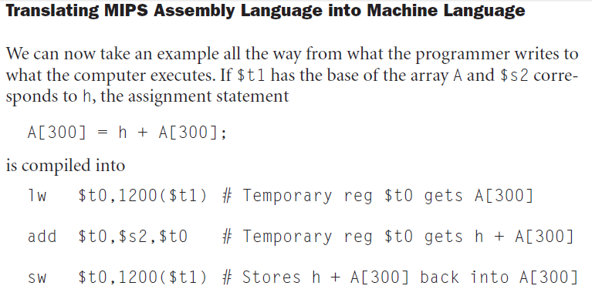



What is the MIPS machine language code for these three instructions?
The lw instruction is identified by 35
The base register 9 ($t1) is
specified in the second field (rs)
Destination register 8 ($t0) is
specified in the third field (rt).
The offset to select A[300] is found in
the final field (address).
let’s first represent the machine language instructions using decimal numbers . . .
NOTE: ...2048 1024 512 256 128 64 32 16 8 4 2 1

Slide 72

Summary for you…
Courtesy: Patterson, David A & J L Hennessy, Computer Organization & Design 3rd Ed.

Slide 73
Let’s learn logical instructions
Session – 8
Shriram K Vasudevan

Slide 74
Logical Move!
Operations supported:
Shift
Shift Left → Instruction → sll
Shift Right → Instruction → srl
AND (bitwise)
and / andi
OR (bitwise)
or / ori
NOT (bitwise)
nor (no nor immediate)

Slide 75
Let us learn one by one, logically! SLL and SRL:
First, let us take Shift operations.
The shift can be done to the left or right based on the instruction.
Also, the emptied bits shall be filled with 0s just following the shift tradition.
Let us meet a situation to understand the shifting!
Assume that $S2 has got following content: (32 Bits, don’t forget)
11ten = 0000 0000 0000 0000 0000 0000 0000 0000 1011two
Let us do a shift left by 4 with the above input. After shifting, the result what we get would be:
176 ten = 0000 0000 0000 0000 0000 0000 1011 0000 two
Let us also do a shift right by 4 with the above input (176 ten)
176 ten = 0000 0000 0000 0000 0000 0000 1011 0000 two after shift right by 4,
11ten = 0000 0000 0000 0000 0000 0000 0000 0000 1011two
Moral of the story – SLL is complement for SRL

Slide 76

Contd.,
The instruction to perform the SLL is presented below. The result is expected to be moved to $t3. The content to be shifted is present in $s2.
sll $t3,$s2,4 # reg $t2 = reg $s2 << 4 bits
Time has come to use the SHIFT field in the R – Type Instruction. (Remember??, we marked it not applicable, earlier)

Slide 77

Additional Responsibility of SLL
Shifting left by n bits gives the same result as multiplying by 2^n.
How this is possible? Simple, see below.

Slide 78

and it is AND!
AND needs both the bits to be 1. You remember AND truth table?
Let us take a situation:
Register $t2 has the following content:
0000 0000 0000 0000 0000 1111 0000 0000two
Register $t1 has the following content:
0000 0000 0000 0000 1111 1100 0000 0000two
We got to AND these two. Result to be stored in $S1
and $s1,$t1,$t2 # reg $s1 = reg $t1 & reg $t2
0000 0000 0000 0000 0000 1100 0000 0000two (Hope you understand) . . .
AND Can be used for BIT MASKING! WHAT WE DID HERE IS “MASKING” and nothing else!

Slide 79

now it is OR, or we quit!
When there is AND, there is OR as well.
Again, refer the truth table. If 1 is there at A or B, result is 1.
Register $t2 has the following content:
0000 0000 0000 0000 0000 0011 0000 0000two
Register $t1 has the following content:
0000 0000 0000 0000 0011 1110 0000 0000two
We got to OR these two. Result to be stored in $S1
OR $s1,$t1,$t2 # reg $s1 = reg $t1 | reg $t2
0000 0000 0000 0000 0011 1111 0000 0000two

Slide 80



NOT through NOR!
NOT is inversion operation and as you know, ‘0’ becomes ‘1’ and ‘1’ becomes ‘0’.
Let us assume:
$t0 has the following content:
0000 0000 0000 0000 0000 1100 0000 0000two
And Register $t1
has the value “0”
Now,
The instruction is:
nor $S1, $t0, $t1 # here, it is equal to $S1 = ~ ($to | $t1)
1111 1111 1111 1111 1111 0011 1111 1111two (We got the NOT of the INPUT)

Slide 81

Your do it yourself.
andi
ori
A Summary!

Slide 82
Decision making instructions
Session – 9
Shriram K Vasudevan

Slide 83
Decision Making
The best part of a computer (i.e. Processor) is the ability towards making decisions. A calculator may not be that intelligent as a computer, from this particular aspect. N
When the input data changes dynamically during runtime, there is a certain need to pull out different set of instructions. (if A, Call X. if B, Call Y)
We are familiar with this in our high level programming languages through if, if else, while, do while etc. History has used goto as an option as well, which slowly has disappeared in the modern programming world.
MIPS is supporting 2 such instructions BEQ and BNE.

Slide 84
Contd.,
The first instruction to be learnt is “BEQ” which can be expanded as Branch if Equal.
BEQ Reg1, Reg2, Label
What does this instruction imply? Simple. It says that the value in the reg1 shall be compared with value in reg2. if found equal, the branching shall happen to the label.
The second instruction is “BNE” which gets expanded as Branch if Not Equal.
BNE Reg1, Reg2, Label
It means go to the statement labeled L1 if the value in register1 does not equal the value in register2.
The mnemonic bne stands for branch if not equal.
These two instructions are traditionally called conditional branches
Slt is homework. Try it out yourself.

Slide 85


Contd.,

Slide 86
While – let’s learn it for a while.
Why important?
Iterative operations are carried out with Loops (after checking for conditions).
Recollect what do we do with traditional while loop in the C Programming.
An instance shall be handy.
Let us write code for while in MIPS with having C code as reference.

Slide 87



Slide 88
Let us know SWITCH - CASE
You know what is switch-case. It provides comfort for the programmer to select one of alternatives.
Many languages including scripting languages support switch-case.
We do not have switch case supported directly through instructions in MIPS.
But, we have other ideas.
Implement switch case through if-then-else sequence.
Try this out yourself! A simple home work, folks!

Slide 89

A final summary!

Slide 90

Contd.,

Slide 91
Thanks
Shriram K Vasudevan
YouTube: https://www.youtube.com/playlist?list=PL3uLubnzL2TnsFH20zsKOcaViV0Jl_b3h

